Slide 1

Entrepôt Optimisé – A Pocket WMS
Entrepôt Optimisé – Storage Optimizer
Industry
Project Mentor : Dr. Mrs. Gresha S Bhatia
Group Number : 06
Group Members : Riddhi Khole (30)
Sakshee Sawant (51)
Srishti Vazirani (66)

Slide 2
Content
Introduction to Project
Lacuna in the existing System
Problem Statement
Literature Survey
Hardware, Software, tools and the constraints
Block Diagram of the Project (Conceptual Architecture)
Modular Diagram of the Project (Also DFD, Use Case diagram / ER Diagram)
Methodology employed
Algorithms Implemented
Implementation Details (Flowchart, GUI Screenshots, Dataset Used)
Results Obtained (Screenshots)
Evaluation Measures
Conclusion
Future Scope
References
Review Sheet 1
Details of research paper submitted

Slide 3
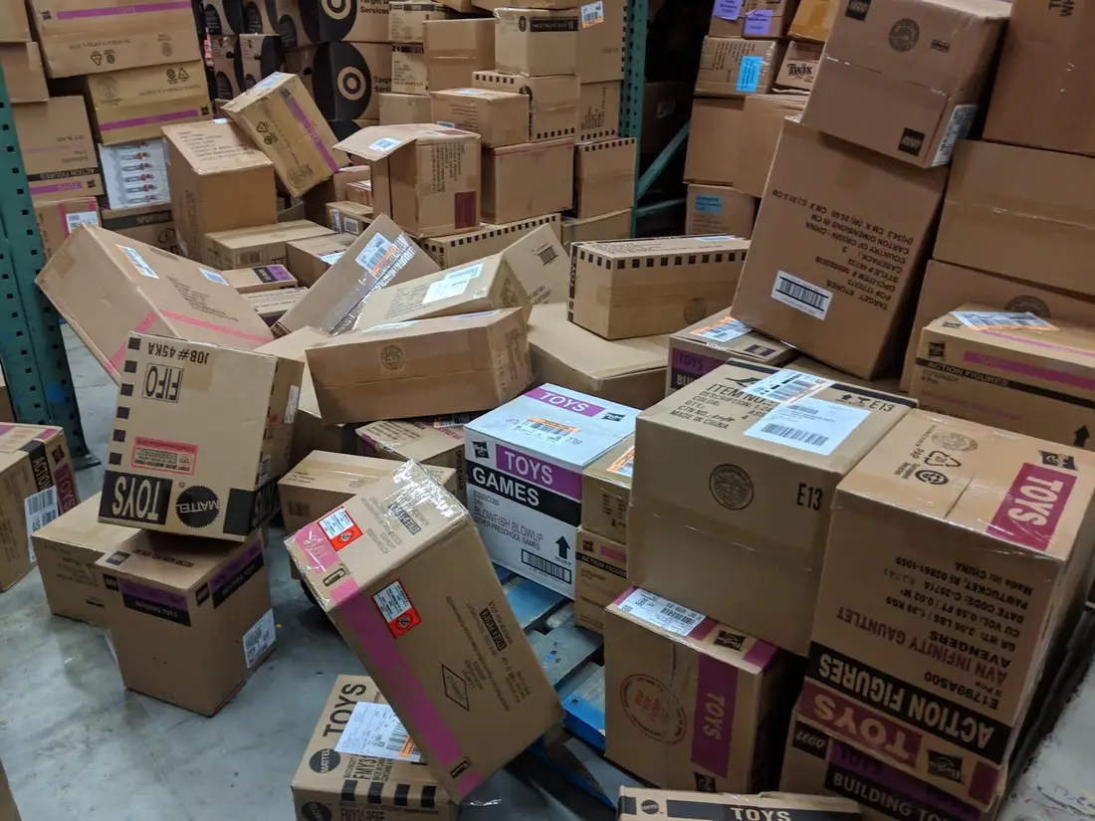
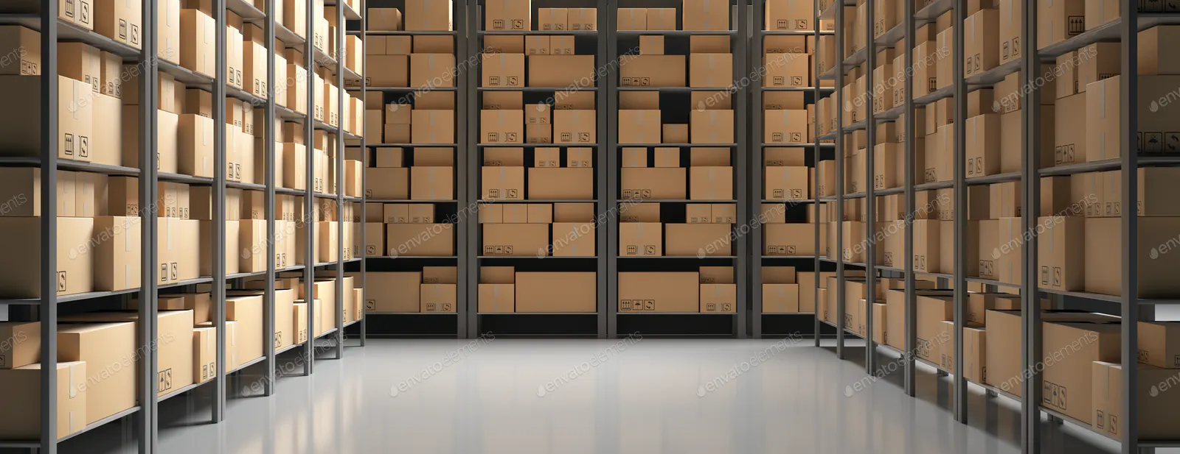
Introduction to Project
As an intermediary step between producers and consumers, warehousing is an important part of logistics systems.
However, due to rising land prices, increasing rents and rapid industrial development, storage areas that were originally sufficient will gradually become insufficient.
A storage strategy is a strategy for the placement of goods in a storage center and is one of the key factors influencing picking efficiency.

Slide 4
Lacuna in the existing system
In previous systems, the company faced a number of problems derived from the low accuracy of storage records, such as:
Delays and loss of orders
Rework and waste of time to find products
Running out of space with boxes spilling into the aisles
Boxes piling up, blocking the way and wasting valuable floor space
Storing products of varying height reduces warehouse storage capacity
The result of this set of problems reflected on the dissatisfaction of the customers, which no longer relied on the delivery performance and quality of operations executed by the company.

Slide 5
Problem Definition
Our main focus is to improve storage location strategy through the use of data technology, including data collection, cluster analysis ,profit prediction to improve order picking efficiency through optimum storage allocation.
Optimizing a warehouse creates conditions in which high-demand items in-demand are always stocked, leading to timely order fulfilment. The application mainly aims to optimize the storage of a warehouse and in the process also maximize the profit.
Thus, Warehouse Management System is directed toward owners of small to large stores and stock managers who are responsible of maintaining sufficient goods on hand in a retail or manufacturing business.
The storage efficiency is shown to be enhanced by the improved strategy.
Notes:
It aims to allocate the location to our products thereby optimising our order processing and use the space available in the best possible way .

Slide 6
Literature Survey
Title | Authors | Year | Description
Warehouse Management System Development Base on Open Source Web Framework | https://ieeexplore.ieee.org/abstract/document/7823494 | 2016 | This paper mainly introduces the basic process and method of warehouse management system established by domestic small and medium enterprises. In terms of WEB design, this paper adopts the bootstrap, which is an open source, beautiful and flexible framework. The whole Web framework adopts Django based on the MTV pattern, and the data is stored in postgresql database.
The Design of Web-based Warehouse Management System | https://ieeexplore.ieee.org/document/7053577 | 2014 | This paper informs us about the drawbacks of the traditional WMS and explains some certain ways by which we can switch to web based WMS. It also focuses on how Web based WMS improves the overall functionality of the warehouse along with its various advantages.
Research and Design of The Intelligent Inventory Management System Based on RFID | https://ieeexplore.ieee.org/document/6804816 | 2013 | This paper guides us that intelligent inventory system is not only function of integrated automatic unattended but also decision-making ability. It introduces the characteristics and basic application of IoT based RFID technology which can be included in the future scope of this project for package tracking.

Slide 7
Hardware, Software, Tools and constraint
HARDWARE :
Microsoft Windows 7/8/10 (32-bit or 64 bit)
4 GB RAM Minimum
2 GB of available disk space minimum
1280 X 800 Screen resolution
SOFTWARE:
Django
ML algorithms
Google Colaboratory
Atom
Python (3.7) 64-bit
MS Excel
Sqlite3

Slide 8
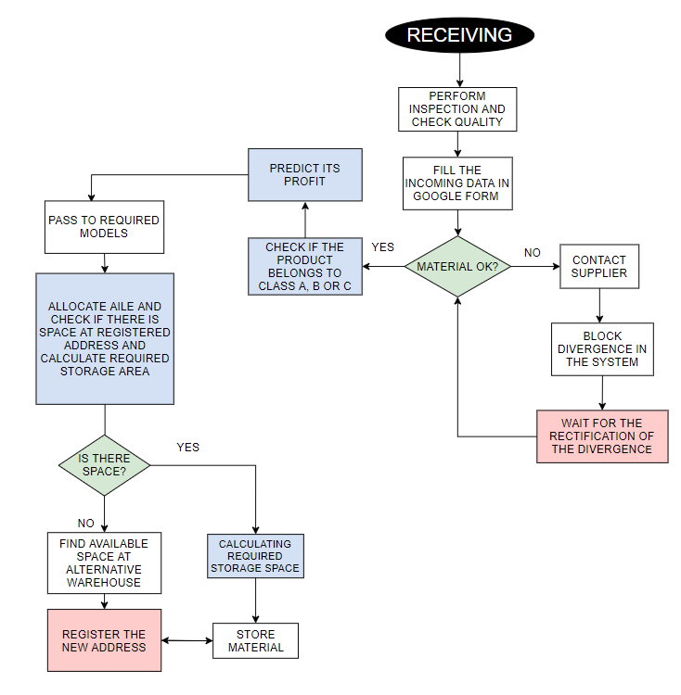
Block Diagram

Slide 9
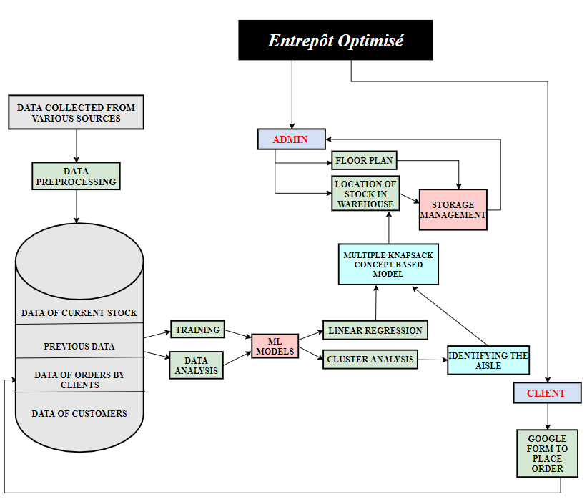
Modular Diagram

Slide 10
Methodology Employed
Receiving and Inspection:
Manages receiving/staging area
Classify products into categories according to relative profit obtained
Allocate most accessible aisles category-wise to reduce allocation and picking distance
Predict profit generated by the product and pass values to main storage allocation model
Designates automatically storage locations
Supports systematic classification of items
Controls quantities
Storage Process:
Controls FIFO
Updates records in real time
Recognizes the physical storage limitation of each address
Checks storage at the correct addresses
Defines usage characteristics for each storage location
Stores accurately
Confirms transfer and replenishment
Notes:
https://www.scielo.br/scielo.php?pid=S0104-530X2018000200370&script=sci_arttext&tlng=en

Slide 11
Algorithms Implemented
Multiple Knapsack
-- For each bin, the code displays the items placed that bin, as well as the bin's total profit and volume occupied.
-- The code also displays the overall total profit and volume of the packed items.
Regression
-- Predicting profit associated with each product.
Clustering
-- Used to categorize the data in clusters A, B, C according to their relative profit.

Slide 12
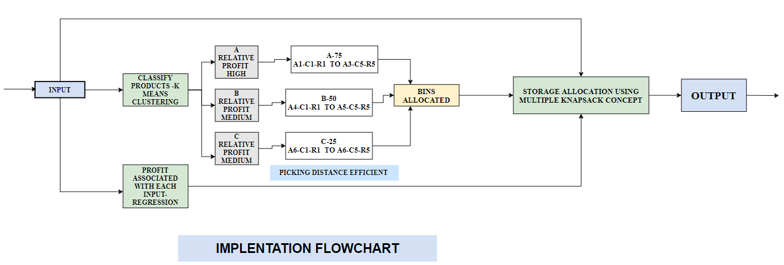
Implementation Details (Flowchart)

Slide 13
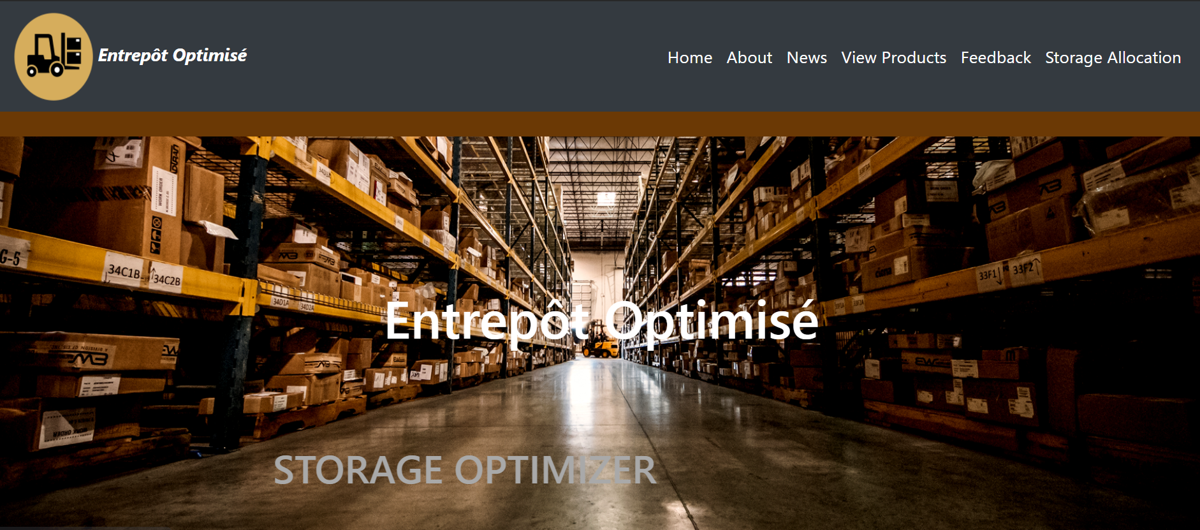
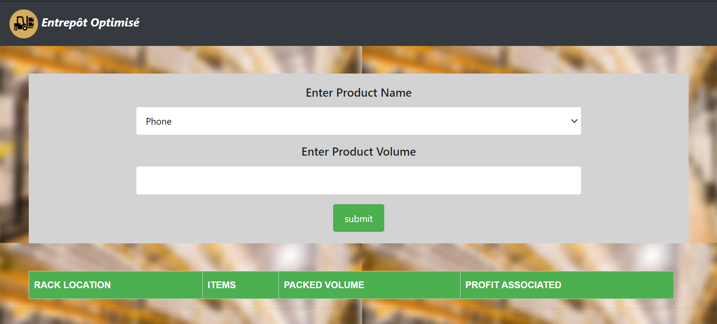
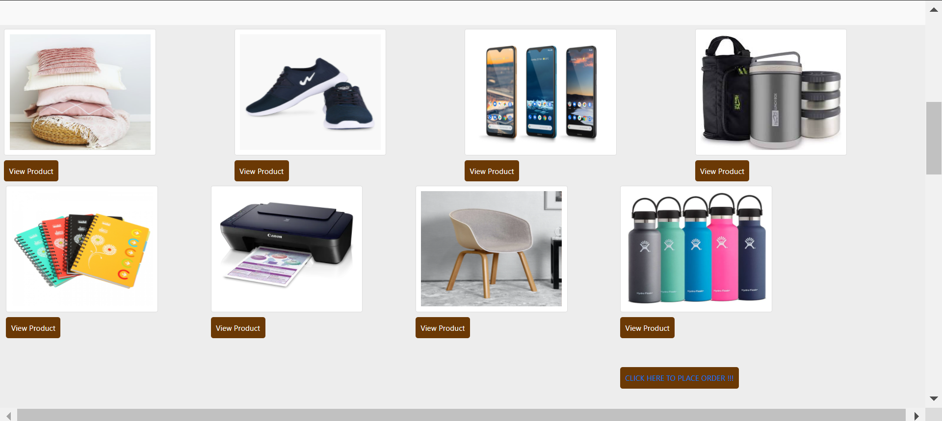
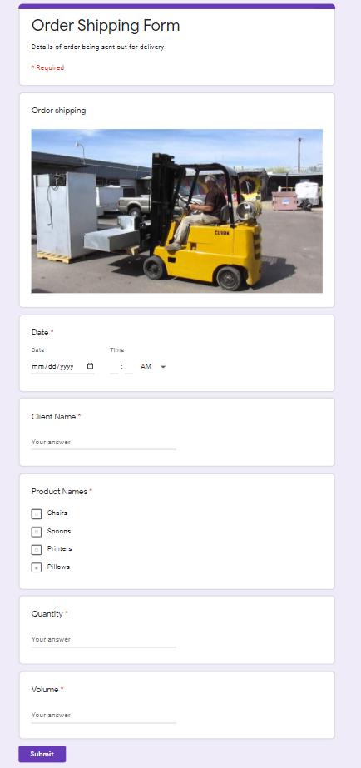
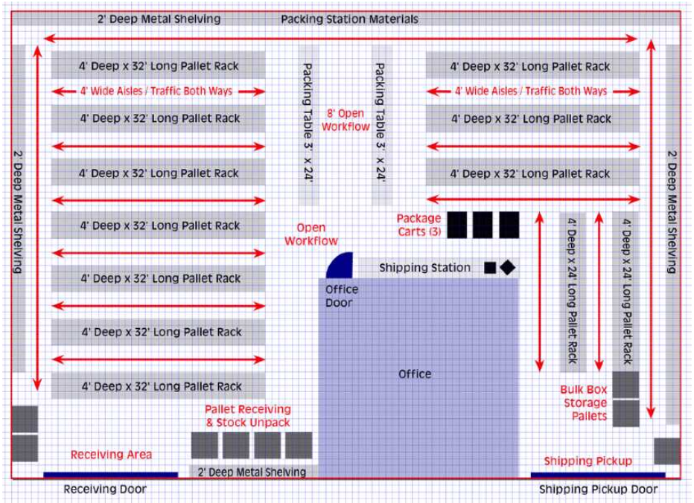
Implementation Details ( GUI Screenshots)

Slide 14
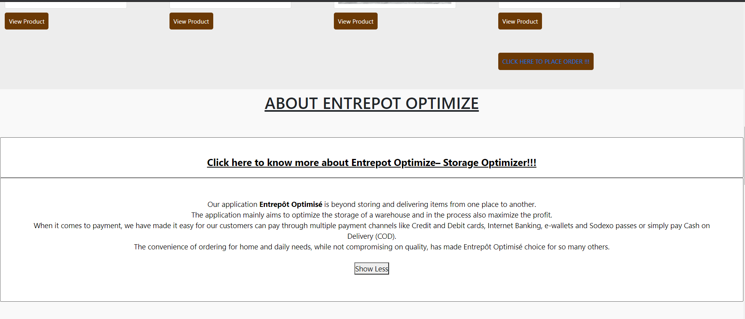
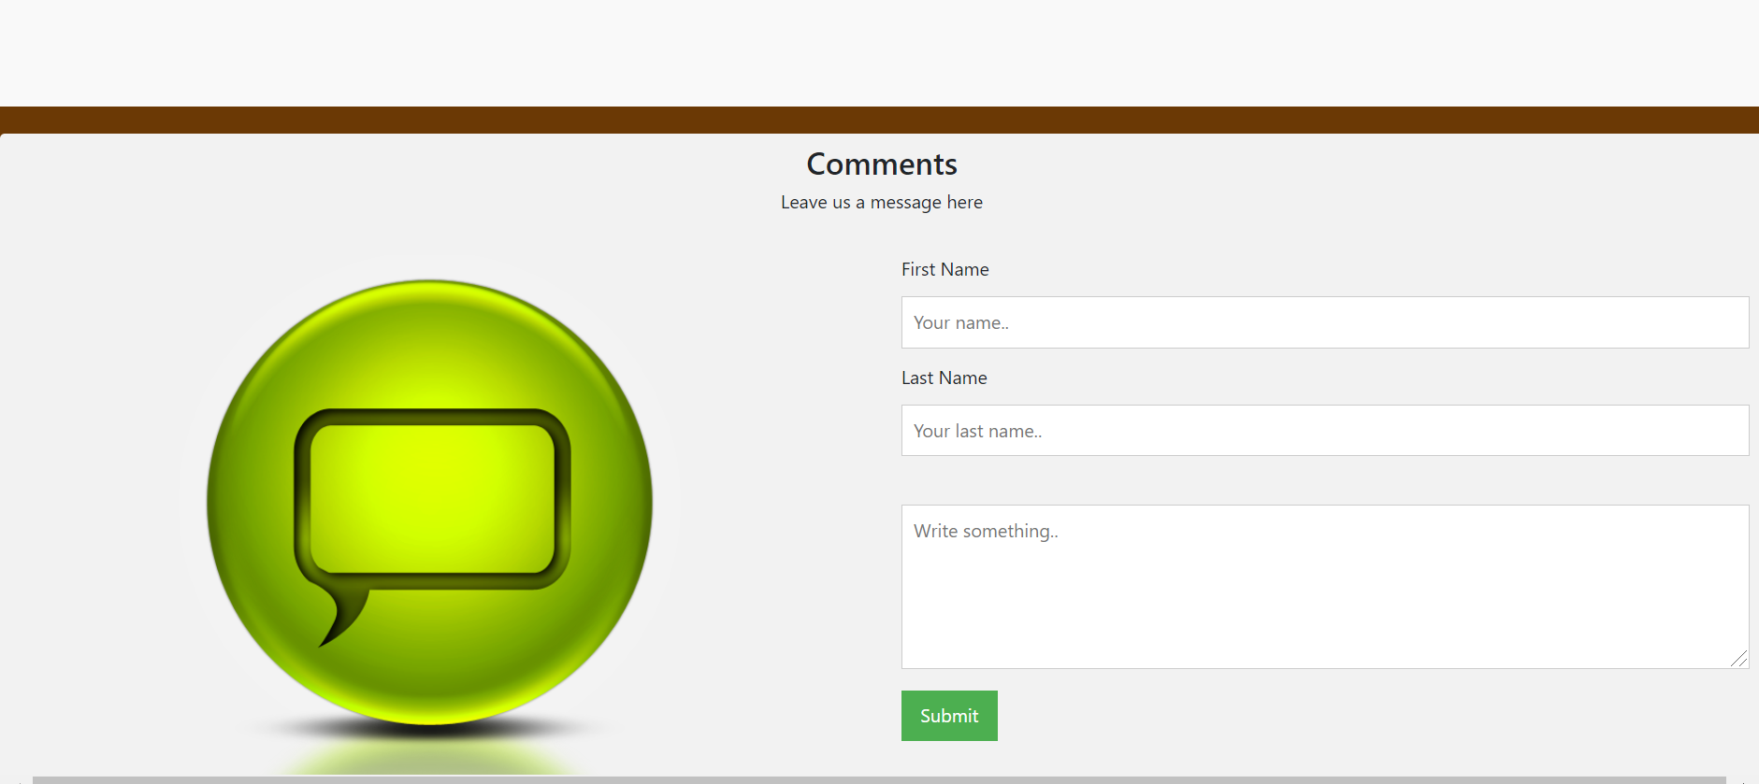
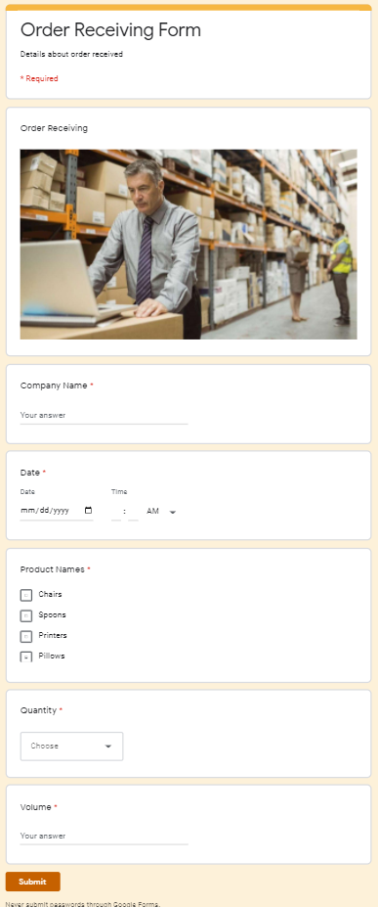
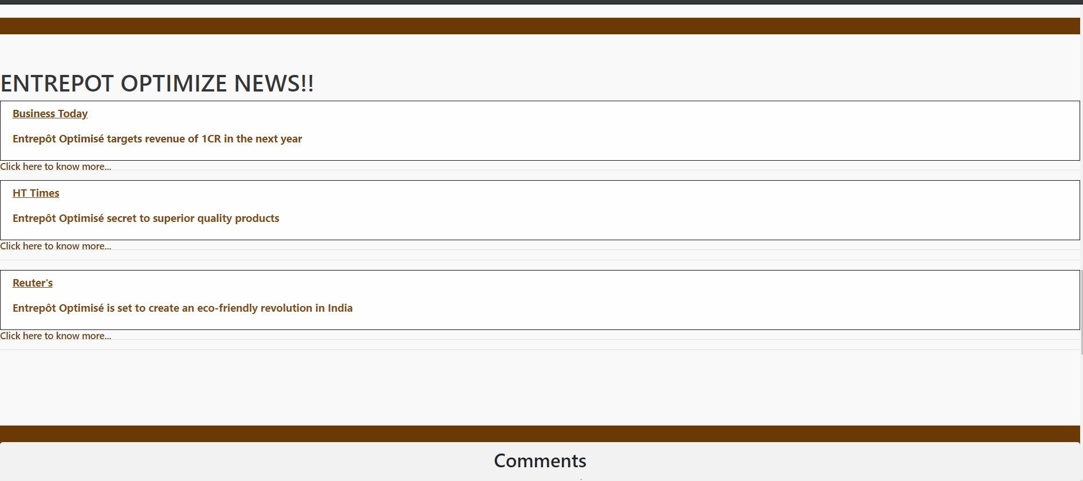
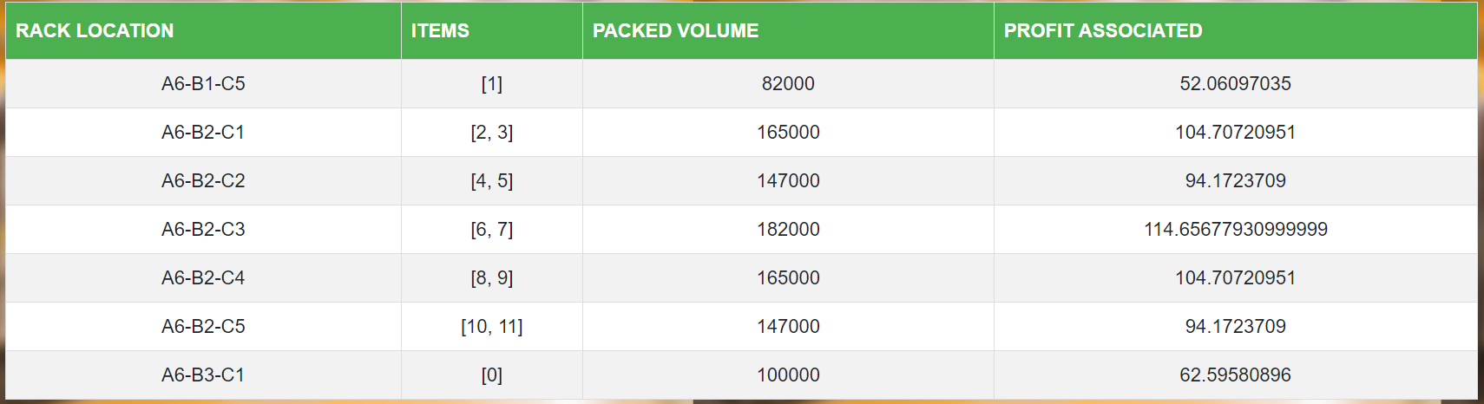
Implementation Details ( GUI Screenshots)

Slide 15
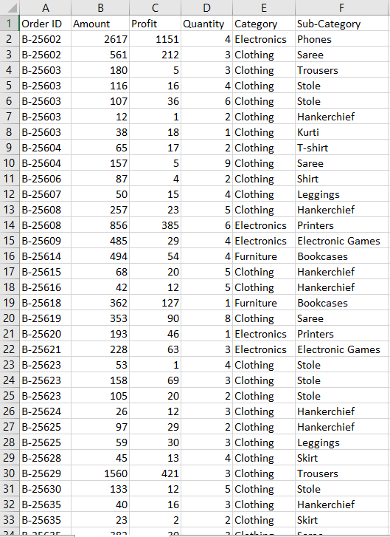
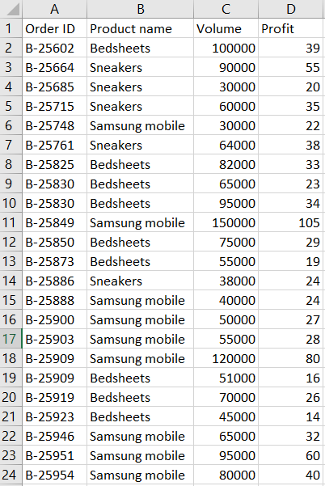
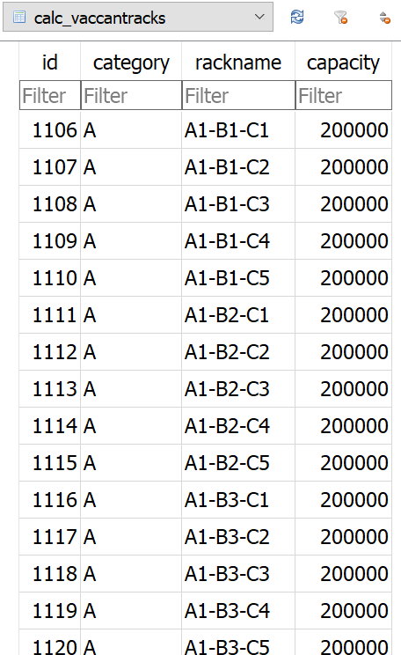
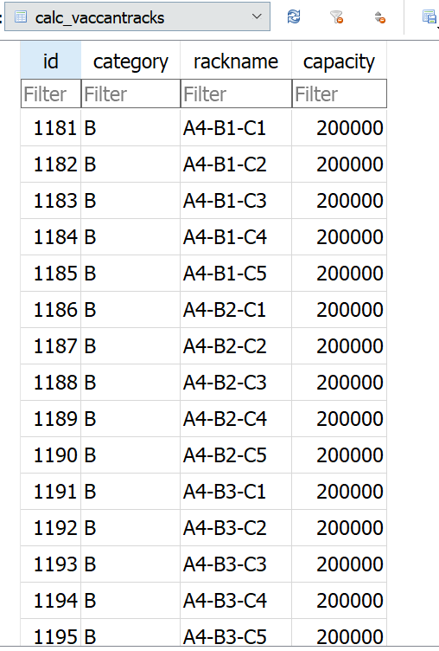
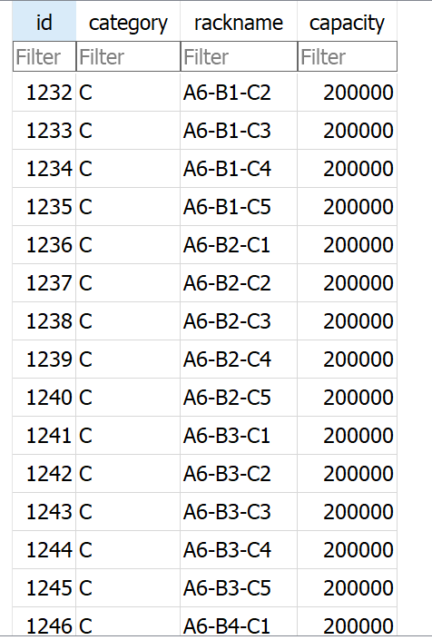
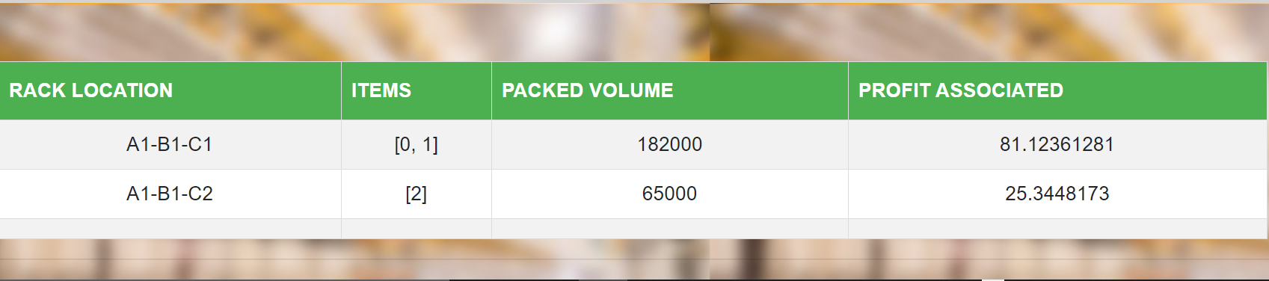
Implementation Details (Dataset Used)
Datasets:
Rack Allocation Dataset:
Product Info Dataset:

Slide 16
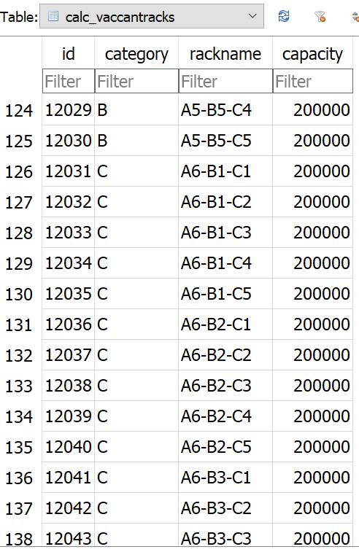
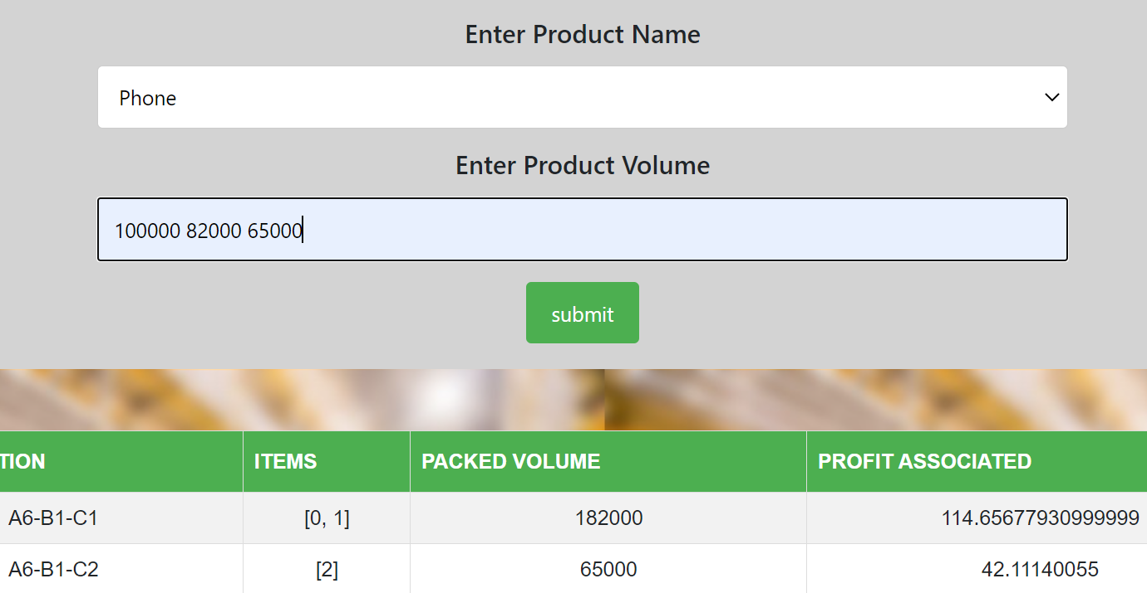
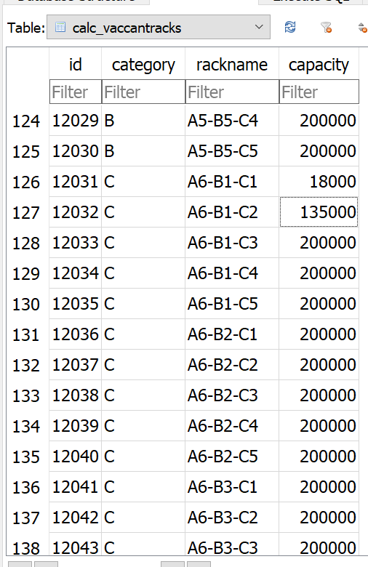
Result Obtained (Screenshots)

Slide 17
Evaluation Measures
Planned
→ Admin, Client Login
→ Storage allocation using ML algorithms
→ Floor Plan layout planning
Achieved
→ Storage allocation and optimization using Multiple Knapsack
→ Category based aisle allocation reducing picking distance
→ Using ML algorithm to identify product categories
Extra features achieved
→ Profit optimization
Notes:
Detailed module descripton

Slide 18
Conclusion
With the intensifying competition among e-commerce companies, the storage efficiency achieved in e-commerce warehouses is a very important concern in e-commerce logistics.
The practical significance of our project is that it presents an improved class-based storage strategy for e-commerce storage centers.
This improvement is of great significance to e-commerce enterprises because it helps them to increase their picking efficiency and picking speed in their warehouses and thus to shorten the time required for order fulfillment logistics, reducing the time consumers must wait for their goods and enhancing the shopping experience.

Slide 19

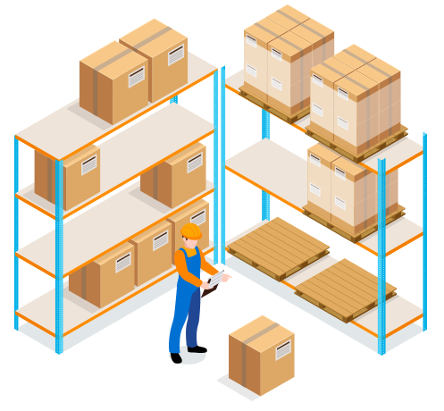

Future Scope
Barcode scanning and generation facility for goods.
Sales prediction for warehouse.
Reduce picking time by keeping certain products together
Sparing and allocating space for emergencies.

Slide 20
References
https://ieeexplore.ieee.org/document/4279857
https://ieeexplore.ieee.org/abstract/document/7823494
https://ieeexplore.ieee.org/document/8587004
https://www.skubana.com/blog/warehouse-optimization#:~:text=Importance%20of%20Warehouse%20Optimization,-Inventory%20management&text=Prioritizing%20efficiency%20ensures%20timely%20order,a%20productive%20and%20profitable%20environment.
https://ieeexplore.ieee.org/document/8343688
https://ieeexplore.ieee.org/document/7053577
https://ieeexplore.ieee.org/document/6804816

Slide 21
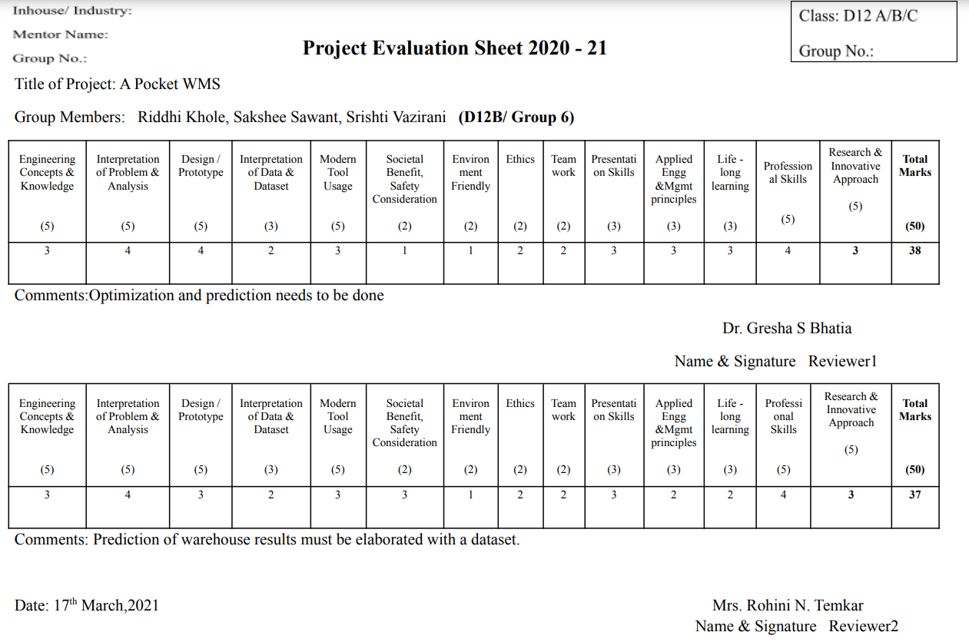
Review Sheet 1

Slide 22
Research Paper Draft

